Slide 1
Course-level social belonging: Effects on student performance and persistence in General Chemistry
Gina Frey
Department of Chemistry University of Utah
04/30/2022
University of Utah

Slide 2
Cognitive
Student Performance/ Persistence
Educational
Affective
04/30/2022
University of Utah

Slide 3
Social Identity
Social Identity: self-concept derived from membership in social groups (Tajfel & Turner et al., 1979)
Age, ability, ethnicity, first language, gender, national origin, race, religion, sexual orientation, socio-economic status…
Individuals’ multiple identities are salient in different contexts, can intersect/ interact in complex ways
Identity threat: when individuals fear their treatment will be contingent on one of their social identities (Steele, Spencer, Aronson, 2002; Walton, Murphy, Ryan, 2015)
Students’ social identities shape how they
Gather information about how they are welcomed and valued by their peers
Interpret feedback
Are aware of numerical diversity in their environment
04/30/2022
University of Utah

Slide 4
Social Belonging
Belonging or having stable, positive relationships with others is a basic human need (Baumeister & Leary, 1995)
Connectedness to a social, spatial, cultural, professional, or other type of group or a community (Hurtado & Carter, 1997).
“The extent to which individuals feel like a valued, accepted, and legitimate member in their academic domain.” (Fink et al., 2020)
“Academic domain” can be an institution (i.e., The University of Utah), a field of study (i.e., chemistry), a class (i.e., General Chemistry)
04/30/2022
University of Utah

Slide 5
Social belonging is important in academic settings
Social belonging is an important psychological factor associated with college-student motivation, achievement, and retention (Murphy & Destin, 2016)
Groups underrepresented in higher education and in STEM often report less belonging (Trujillo & Tanner, 2012) and more uncertainty about their belonging (Walton & Cohen, 2007, 2011)
Independent effects of different levels of belonging – course, major, and university – on undergraduate STEM students’ behavioral and emotional engagement in their courses, with course-level belonging proving most influential (Wilson et al., 2015).
The impacts of social belonging and other affective factors on outcomes in STEM are being studied across gender and racial/ethnic identities, and the effects on other underrepresented groups (e.g., first-generation students) are less understood.
04/30/2022
University of Utah

Slide 6
Two facets of Social Belonging
Sense of Belonging
Perceived belonging reflects students’ overall evaluations of their fit and social relationships in educational settings, indicating whether they generally agree or disagree that they belong.
Belonging Uncertainty (less studied)
Term introduced by Walton and Cohen (2007)
Awareness of educational inequities and stereotypes, experiences with discrimination, and other threats to inclusion can cause students from underrepresented groups to question or doubt the quality of their social connections in educational settings (Mallett et al., 2011).
Probes the relative stability and performance contingency of students’ perceived belonging
04/30/2022
University of Utah

Slide 7
Adapted course-level belonging measures
Sense of belonging (SB)
I feel like I fit in General Chemistry.
I feel comfortable with my peers and classmates in General Chemistry.
I feel comfortable with my professors in General Chemistry.
Setting aside my performance in class, I feel like I belong in General Chemistry.
Belonging Uncertainty (BU)
I feel uncertain about my belonging in General Chemistry (i.e., sometimes I feel that I belong, sometimes I don’t)
When I don’t perform well, I feel like maybe I don’t belong in General Chemistry.
Strongly Disagree | Disagree | Mildly Disagree | Mildly Agree | Agree | Strongly Agree
1 | 2 | 3 | 4 | 5 | 6
Adapted: Both scales, Fink et al (2020); People in General Chemistry are a lot like me.
SB original: (London et al., 2013; Walton & Cohen, 2007, 2011); BU original (Walton & Cohen, 2011)
04/30/2022 University of Utah

Slide 8
Why look at belonging in General Chemistry?
Most students are experiencing a critical period of personal and academic development.
The transition to college is challenging for most students (Tinto, 1993), but compounded for students from under-resourced or marginalized groups who may feel alienated by the cultural norms of the institution (e.g., Stephens et al., 2012)
May prove especially acute in large-enrollment, lecture-based, introductory STEM courses like general chemistry, where rigorous coursework is combined with an unfamiliar learning environment and often limited opportunities for individual participation during class.
Understanding how early belonging varies and impacts first-year students’ success in general chemistry may point chemical educators towards new strategies for supporting their students and retaining more talent in STEM and healthcare fields.
04/30/2022
University of Utah

Slide 9
Studies at 2 different institutions
Washington University in St. Louis
Private highly selective research-intensive institution
University of Utah
Public land-grant research-intensive institution
Both large General Chemistry courses with multiple sections taught as a single section (N = 800-900)
Multiple instructors
Sections have same homework, quizzes, exams, syllabi, and all students are graded commonly with same absolute grading scale
04/30/2022
University of Utah

Slide 10
What are the impacts of student social belonging on student outcomes in General Chemistry?
How does social belonging in General Chemistry differ according to demographics (i.e., gender, race/ethnicity, & first generation) and academic preparation (i.e., math abilities, content knowledge, & college–preparatory experience)?
How does social belonging affect performance and persistence in General Chemistry series?
How do these effects differ according to demographics (i.e., gender, race/ethnicity, & first generation) and academic preparation (i.e., math abilities, content knowledge, & college–preparatory experience)?
Is there a recursive effect between social belonging and course performance?
How do these effects differ according to demographics (i.e., gender, race/ethnicity, & first generation) and academic preparation (i.e., math abilities, content knowledge, & college–preparatory experience)?
04/30/2022
University of Utah

Slide 11
Key Findings from the 2 Studies
In two institutions with different populations, large GC courses,
Generalizability of course-level social belonging survey instrument with 2 factors
Sense of Belonging and Belonging Uncertainty are statistically separate factors
What affects early-semester SB and BU:
Gender difference in SB and BU: Men had higher SB and lower BU than women
Inconclusive about academic background affecting early SB/BU
At Wash U, AP and pre-content knowledge (not ACT Math) affected SB and BU for all students
Not seen at Utah
Small size effect (0.03 – 0.07)
04/30/2022
University of Utah

Slide 12
Additional Key Findings from Wash U
Early-semester SB/BU affects performance (cumulative final exam score) in both GC1 and GC2 for all students
After taking into account academic background (ACT, 1.2 pts; Pre, 0.18 pt), PLTL participation (5 pts)
Approximately 1.7 points on exam for 1 point in SB or BU (SB GC1; SB & BU GC2)
Persistence in the series: Late semester SB affects continuing and finishing second semester GC2
After adjusting for academic preparation, demographics, PLTL participation, & GC1 performance
As late-semester GC1 SB increased from 4 (mildly A) to 5 (A) to 6 (SA), her predicted probability of attrition decreased from 20.2% to 6.2% to 0.6%, respectively (an average-preparation Asian, female, PLTL non-completer)
04/30/2022
University of Utah

Slide 13
Why might belonging affect performance (one current model; not yet shown in science, math, and engineering)?
Supportive Classroom Environment
Sense of Belonging
Engagement in Academic Activities
Motivation
Achievement
Recursive Process: affect-cognition-behavior chain is thought to be cyclic and self-reinforcing, such that negative self-perceptions contribute to maladaptive learning strategies and poor performance, which beget more negative perceptions, and so on (Yeager & Walton, 2011).
Zumbrunn, McKim, Buhs, Hawley, 2014
04/30/2022
University of Utah

Slide 14
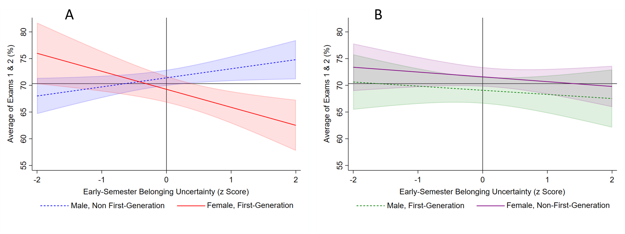
Recursive Process Study - Utah Study
Recursive process seen in GC1
Step 1: After Accounting for Academic Preparation (ACT Math and Pre- assessment Test), Early-Semester Belonging Uncertainty Negatively Affected Midterm-Exam Performance (Average of Exams 1 and 2) Only for the Intersectional Group of First-Generation Students and Women
ACT math (1.3 pts); Pre-knowledge (0.9 pts) for all students
04/30/2022
University of Utah

Slide 15
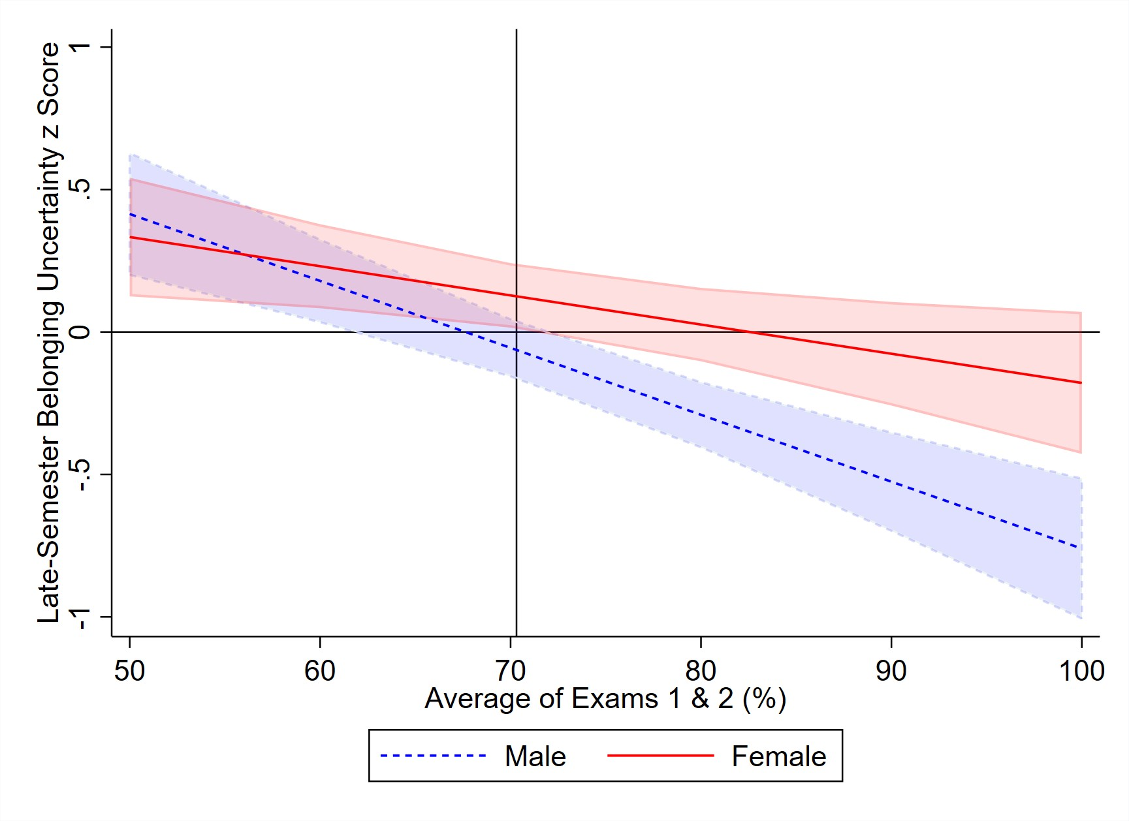
Recursive Process Study - Utah Study
Step 2: Mid-term performance predicted late-semester social belonging (both factors) for all students.
Pre-knowledge and ACT Math did not predict SB or BU
Example of mid-term performance on SB and BU
A student having an 80% average would be expected to report a BU score that is 0.17 standard deviation above the BU score of a student with a 90% exam score
Women again experience higher BU score than men, even with
comparable exam performance
04/30/2022
University of Utah

Slide 16
Recursive Process Study - Utah Study
Step 3: Late-semester sense of belonging predicted noncumulative final exam performance.
Again pre-knowledge and ACT Math predicted exam score similar to the early exam score effect (ACT math (1.4 pts); Pre-knowledge (0.9 pts) for all students)
Late semester SB (but not BU) predicted exam score for all students; 4pts higher on exam for 1 standard deviation increase in SB score
Early- semester Social Belonging
Late- semester Social Belonging
Midterm Achievement
Achievement
04/30/2022
University of Utah

Slide 17
Why might belonging affect performance (one current model; not yet shown in science, math, and engineering)?
Supportive Classroom Environment
Engagement in Academic Activities
Belonging
Motivation
Achievement
Recursive Process: affect-cognition-behavior chain is thought to be cyclic and self-reinforcing, such that negative self-perceptions contribute to maladaptive learning strategies and poor performance, which beget more negative perceptions, and so on (Yeager & Walton, 2011).
Zumbrunn, McKim, Buhs, Hawley, 2014
04/30/2022
University of Utah

Slide 18
Implications for instructors
Create a inclusive and supportive environment
Check material and language
Include examples of different genders, races/ethnicities, first generation, etc.)
Encourage growth mindset for both instructors and students
A belief that all learners’ can grow and improve. Set your assessments to encourage this process. Reinforce at critical points in the semester (e.g., after each exam has been taken) when students struggle to maintain positive self- beliefs.
Use multiple types of assessments and lower percentage of grade that is based on number of high-stakes assessments
Target motivation: e.g., Use utility-value interventions
Target Engagement: e.g., Use active-learning, collaborative strategies
Use multiple interventions and reinforce throughout the semester and into the second semester of the course
04/30/2022
University of Utah

Slide 19
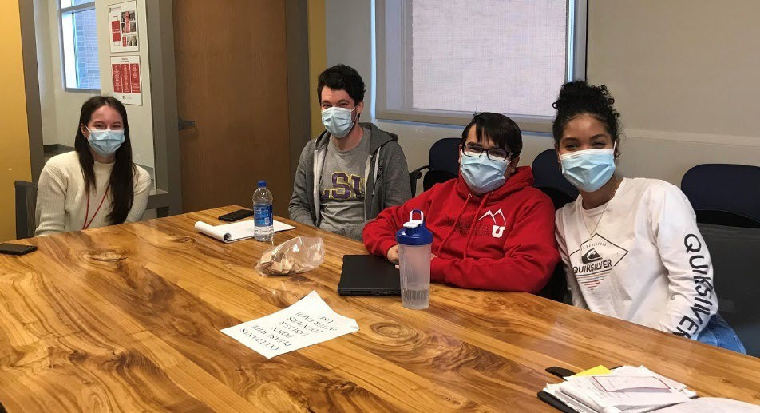
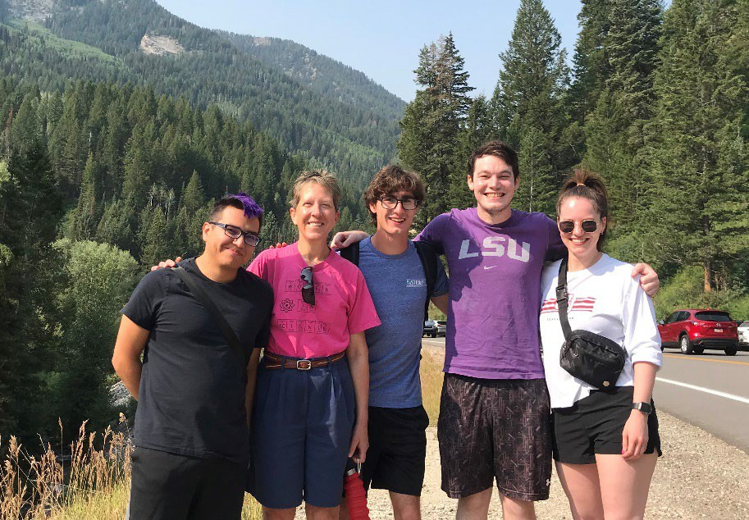
Group members and Collaborators
Current Group Members
Graduate Students
Josh Edwards
Lori Laguerre
Hector Torres
Undergraduate Researchers
Hannah Blomgren
Dasha Walker
Eva Quintus-Bosz
Salma Djalal
Maria Munoz
Sophie Humpherys
Mark Jareczak (REU; Wash U)
Group Website: https://chem.utah.edu/directory/frey/research-group/
Collaborators
Ramón Barthelemy, The Department of Physics, Utah
Effect of Classroom Inclusivity on student outcomes in STEM
Center for Science and Mathematics Education (CSME; Utah)
Learning Assistant (LA) project
HHMI UPSTEM project
Center for Integrative Research on Cognition, Learning, and Education (CIRCLE; Washington University in St. Louis)
Peer Led Team Learning (PLTL) project
Classroom Inclusivity and social belonging project (HHMI)
Concept-building Approach project
Social Network Analysis (HHMI)
Inclusive STEM Teaching Project (Multi-institutional NSF Grant)
Faculty/Future Faculty online Inclusive Teaching program
04/30/2022
University of Utah

Slide 20
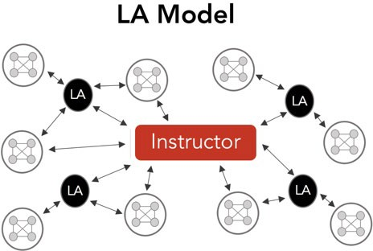
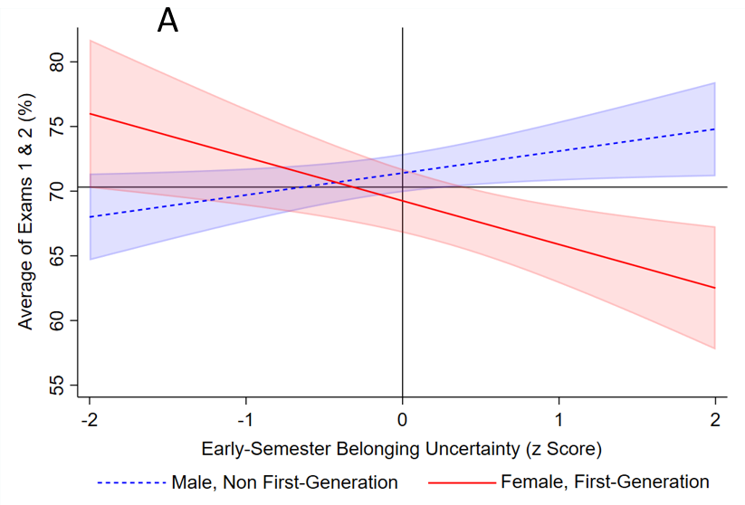
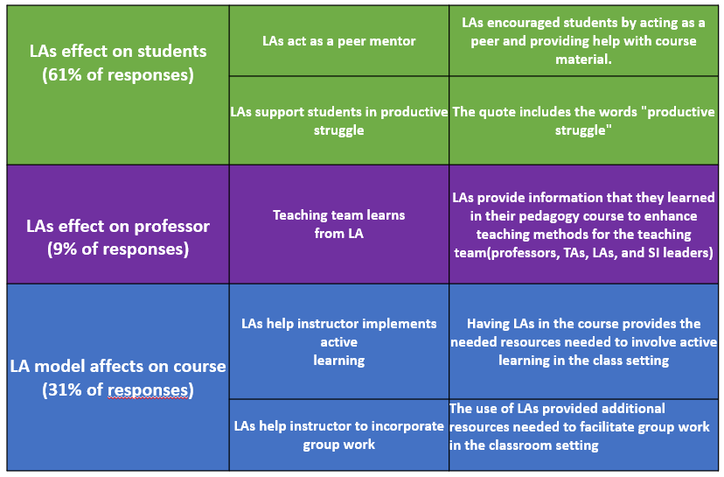
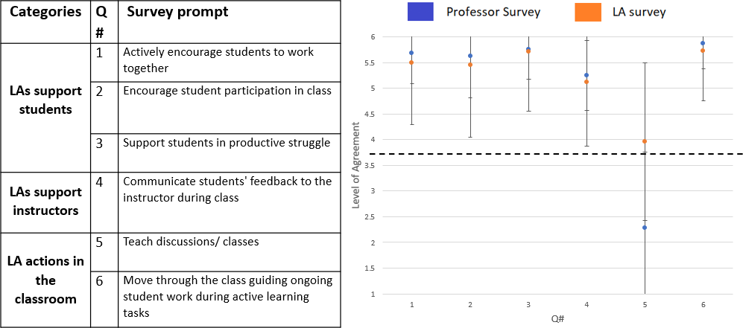
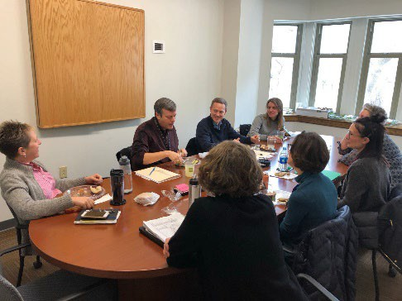
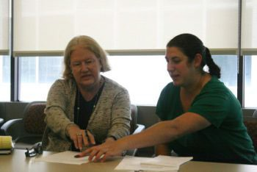
Social Belonging and Inclusive Learning Environments
Peer-Assisted Collaborative Learning
Peer Leaders include roles of LA, SI, PLTL, and undergraduate TA. We are looking at Learning Assistants (LAs) who facilitate discussions among groups of students in classroom settings to encourage active engagement. Our group studies LA implementation and their effect on classroom inclusivity.
Projects:
Frey Group Research
Social Belonging
Sense of Belonging
Belonging Uncertainty
UofU faculty LA implementation in STEM
UofU LA course inclusivity in STEM
Study methods used
Survey
Interviews
Projects:
Belonging in UofU general chemistry, organic chemistry, introductory physics
Belonging in SLCC introductory biology
Cognition and Metacognition
Research Questions:
1. What types of self-directed study behaviors do STEM students
Faculty development
With an ever-changing student demographic, instructors often look for new strategies in which they may help to build an equitable learning environment so that all students may succeed in their course.
have and what is the effect on their performance?
2. What effect does academic mindset have on self- directed study behaviors of STEM chemistry students?
Projects:
Multi-institution on-line faculty development course with local learning communities (ISTP)
UofU and SLCC faculty- learning community
3. What effect does social belonging have on self-directed study
behaviors of STEM students?
Purpose
Develop a metacognitive intervention to help students improve their study habits.
Academic Mindset
Research tools and skills we use:
Projects:
Study Habits in UofU general chemistry, organic chemistry
Study Habits in SLCC
Survey instruments
Observational instruments
Cognitive and social psychology
Quantitative and qualitative analysis
Metacognition
Study Habits
Performance
Social Belonging
04/30/2022
^{introductory bioUlongiyversity} G^{of}ro^{U}u^{t}p^{ah}Website: https://chem.utah.edu/directory/frey/research-group/

Slide 21
Thank you for listening.
Questions/Comments?
04/30/2022
University of Utah

