Slide 1
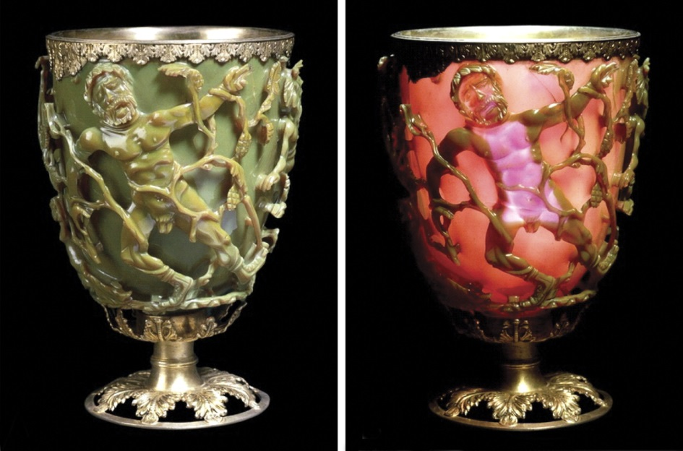
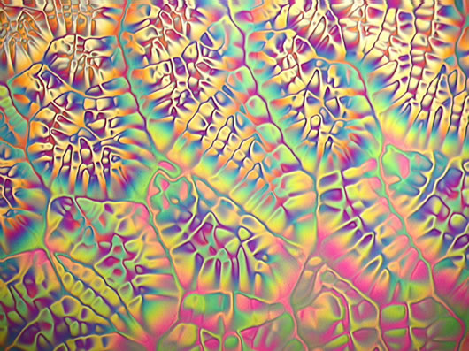
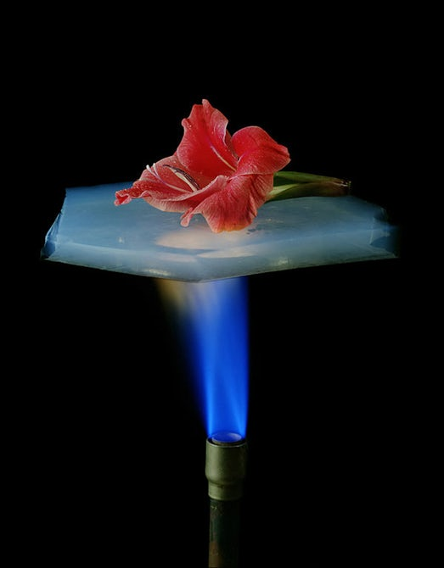
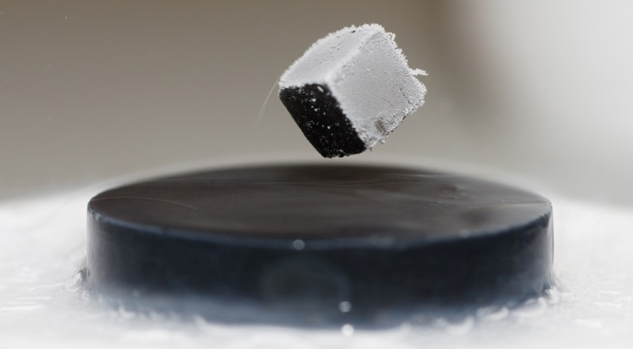
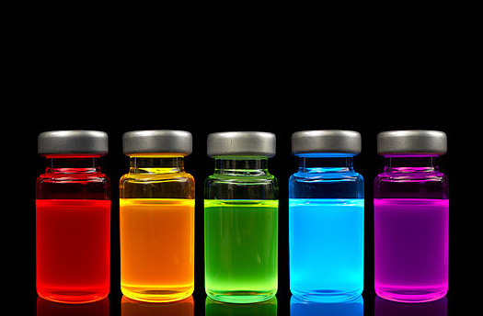
Modern Materials presented by: Michael Morse, University of Utah morse@chem.utah.edu

Slide 2
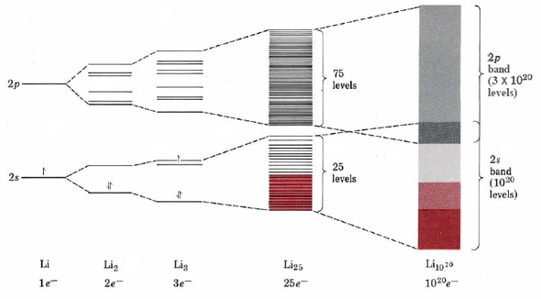
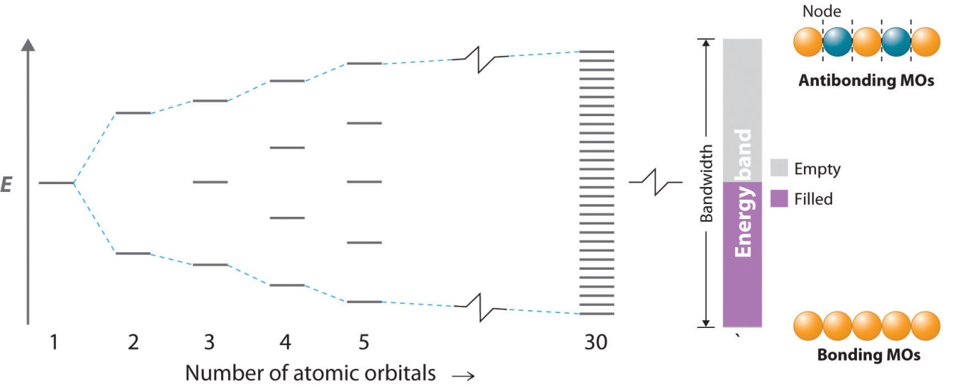
Electronic Materials: Metals
Energy
Emptylevels
p-band
s-band
Filled
levels
Number of atoms
Energy levels in metals are so closely spaced that for all practical purposes they’re continuous. This is why they’re called bands. This allows electrons to flow readily from one part of the metal to another. Very slight changes to the system (such as an applied voltage) is enough to cause the electrons to move. Metals are conductors.

Slide 3
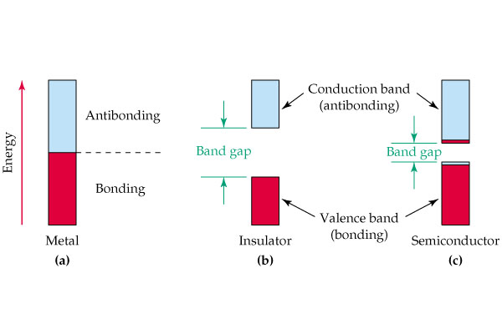
Electronic Materials: Semiconductors
empty orbitals
Empty conduction band
Fermi level
Band Gap
Filled valence band
filled orbitals
Semiconductor –
small band gap
(<350 kJ/mol ~ 3.5 eV)
Metal – no band gap
In semiconductors, the bands consist of a lower energy band, which is completely filled (the valence band) and a higher energy band that is normally empty (the conduction band). They are separated by an energy gap, the band gap.
Semiconductors are poor conductors of electricity, but they get better at higher T (more electrons are thermally excited to the conduction band). This can be used to build thermometers, since the resistance of a semiconductor can be used to measure temperature. Such devices are called thermistors.

Slide 4
Semiconductors – The Band Gap
Band Gaps of some materials:
SiO₂ > 6 eV
Diamond 5.5 eV
Al₂O₃ ~5.5 eV
GaN 3.4 eV
TiO₂ 3.0 eV
CdS 2.4 eV
CdSe 1.7 eV
GaP 2.2 eV
CdTe 1.44 eV
GaAs 1.43 eV
Si 1.1 eV
Ge 0.67 eV
InAs 0.43 eV
InSb 0.23 eV
Empty conduction
band
Band Gap
Insulators
Filled valence band
Semiconductor –
small band gap
(<350 kJ/mol ~ 3.5 eV)
Semiconductors
In semiconductors, the band gap is all-important. If it is too large (>3.5 eV), so few electrons are excited to the conduction band that it is really an insulator for most purposes.
Question: If you wanted to build a device to measure extremely low temperatures (say, in the 10-50 K range), which of the materials listed above would be a good choice for a thermistor? [Hint: the average thermal energy at 50 K is 0.004 eV.]

Slide 5
Semiconductors – The Band Gap
Band Gaps of some materials:
SiO₂ > 6 eV
Diamond 5.5 eV
Al₂O₃ ~5.5 eV
GaN 3.4 eV
TiO₂ 3.0 eV
CdS 2.4 eV
CdSe 1.7 eV
GaP 2.2 eV
CdTe 1.44 eV
GaAs 1.43 eV
Si 1.1 eV
Ge 0.67 eV
InAs 0.43 eV
InSb 0.23 eV
Empty conduction
band
Band Gap
Insulators
Filled valence band
Semiconductor –
small band gap
(<350 kJ/mol ~ 3.5 eV)
Semiconductors
In semiconductors, the band gap is all-important. If it is too large (>3.5 eV), so few electrons are excited to the conduction band that it is really an insulator for most purposes.
Question: If you wanted to build a device to measure extremely low temperatures (say, in the 10-50 K range), which of the materials listed above would be a good choice for a thermistor? [Hint: the average thermal energy at 50 K is 0.004 eV.]
Answer: You need a small band gap, so electrons can be thermally excited above it. InSb should work.

Slide 6
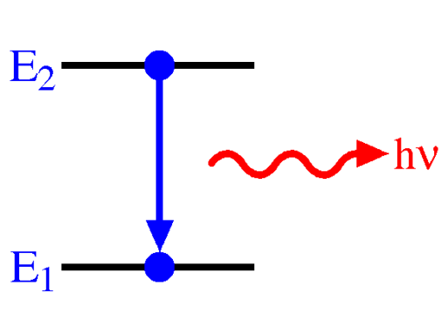
Light emitting diodes
Inject e‒
on this side
e‒
Conduction Band
e‒
e‒
e‒
e‒
e‒
h⁺
h⁺
h⁺
h⁺
h⁺
h⁺
Valence Band
h⁺
Withdraw e‒
on this side
If we inject electrons on one side of a semiconductor, on that side the valence band is filled, so they go into the conduction band.
Withdrawing electrons on the other side takes them out of the valence band (leaving holes – designated as h⁺).
When they diffuse to the other side, the e‒ and h⁺ can recombine by emitting a photon. This is a light emitting diode (LED).

Slide 7
Diode lasers
Inject e‒
on this side
e‒
Conduction Band
e‒
e‒
e‒
e‒
e‒
h⁺
h⁺
h⁺
h⁺
h⁺
h⁺
Valence Band
h⁺
Withdraw e‒
on this side
If you put partially reflecting mirrors around a light emitting diode,
the emitted light can bounce back and forth, stimulating more electron-hole recombinations and creating additional photons traveling in the same direction. This makes a laser – and even better, it can be powered by a simple battery, and miniaturized to fit in your pocket!

Slide 8
Diode lasers
Conduction Band
Valence Band
Question: What controls the wavelength that
comes out of an LED or a diode laser?

Slide 9
Diode lasers
Band Gaps of some materials:
SiO₂ > 6 eV
Diamond 5.5 eV
Al₂O₃ ~5.5 eV
TiO₂ 3.0 eV
CdS 2.4 eV
CdSe 1.7 eV
GaP 2.2 eV
CdTe 1.44 eV
GaAs 1.43 eV
Si 1.1 eV
Ge 0.67 eV
InAs 0.43 eV
InSb 0.23 eV
Conduction Band
Valence Band
Question: What controls the wavelength that
comes out of an LED or a diode laser?
Answer: The band gap! If you want an IR photon,
use a material with a small band gap. If you want
visible, you’ll need a material with a larger band gap
(about 2 eV for red light [620 nm]).
The 2014 Nobel Prize in Physics was given to the scientists
who were able to produce an LED that emitted blue light. They
developed a material based on gallium nitride (GaN).

Slide 10
Semiconductors – Doping
Remember – Semiconductors are actually quite poor conductors.
They conduct only because some electrons are excited into the conduction band,
leaving holes in the valence band.
Electrons thermally excited to conduction band
Holes left behind in the valence band
Charge carriers in semiconductors
can be electrons or holes or both

Slide 11
Semiconductors – Doping
Remember – Semiconductors are actually quite poor conductors.
They conduct only because some electrons are excited into the conduction band,
leaving holes in the valence band.
Electrons thermally excited to conduction band
Holes left behind in the valence band
Charge carriers in semiconductors
can be electrons or holes or both
A semiconductor like Si, can be made slightly conducting by adding a tiny amount (0.2 ppb to 20 ppm) of an electron donor that can substitute for Si in the lattice (like P, which has 5 electrons instead of 4) – putting a few electrons in the conduction band. This creates a semiconductor that conducts quite a bit better than pure Si, with electrons as the charge carriers. Since negative particles (electrons) carry the charge, this is called an n-type semiconductor.

Slide 12
Semiconductors – Doping
Remember – Semiconductors are actually quite poor conductors.
They conduct only because some electrons are excited into the conduction band,
leaving holes in the valence band.
Electrons thermally excited to conduction band
A few extra e‒ in conduction band
Holes left behind in the valence band
Filled valence
band
Charge carriers in semiconductors n-type semiconductor
can be electrons or holes or both
A semiconductor like Si, can be made slightly conducting by adding a tiny amount (0.2 ppb to 20 ppm) of an electron donor that can substitute for Si in the lattice (like P, which has 5 electrons instead of 4) – putting a few electrons in the conduction band. This creates a semiconductor that conducts quite a bit better than pure Si, with electrons as the charge carriers. Since negative particles (electrons) carry the charge, this is called an n-type semiconductor.

Slide 13
Semiconductors – Doping
Remember – Semiconductors are actually quite poor conductors.
They conduct only because some electrons are excited into the conduction band,
leaving holes in the valence band.
Electrons thermally excited to conduction band
A few extra e‒ in conduction band
Empty conduction
band
Holes left behind in the valence band
Filled valence
band
A few holes in
valence band
Charge carriers in semiconductors n-type semiconductor p-type semiconductor
can be electrons or holes or both
A semiconductor like Si, can be made slightly conducting by adding a tiny amount (0.2 ppb to 20 ppm) of an electron donor that can substitute for Si in the lattice (like P, which has 5 electrons instead of 4) – putting a few electrons in the conduction band. This creates a semiconductor that conducts quite a bit better than pure Si, with electrons as the charge carriers. Since negative particles (electrons) carry the charge, this is called an n-type semiconductor.
If we add a few ppb of B, it can substitute for Si, but it only has 3 electrons, not 4. This leaves holes in the valence band, and the holes become the charge carriers. Since the charge carriers are now positive, this is called a p-type semiconductor.

Slide 14
Solar Cells
Some semiconductors are are useful for light emitting diodes (LEDs) and diode lasers
(these have what are called direct band gaps – when the electron drops down to the valence band it can conserve its momentum). Others have indirect band gaps - the electron cannot conserve its momentum when it drops down. Semiconductors with indirect band gaps are not good for LEDs and diode lasers, but they’re good for something else – solar cells (photovoltaics – devices that generate a voltage from light.).
e‒
e‒
e‒
e‒
hν
ΔV
h⁺
h⁺
h⁺
h⁺
Positive terminal
Negative terminal
Hole collector Photoabsorber Electron collector
(usually Si)

Slide 15
Insulators
Empty
conduction
band
empty orbitals
Empty conduction
band
Fermi level
Filled
valence
band
Filled valence
band
filled orbitals
Metal – no band gap
Semiconductor –
small band gap
(<350 kJ/mol ~ 3.5 eV)
Insulator –
large band gap
(>350 kJ/mol ~ 3.5 eV)
Insulators are just semiconductors with a really large band gap!

Slide 16
Superconductors
Although metals conduct electricity very well, electrons flowing in a piece of metal lose energy by collisions with the atoms, converting their kinetic energy into vibrational motions of the metal lattice (heat). This is called electrical resistance, and it explains why tungsten filaments in incandescent lights get hot and glow, and why heaters on electric stoves glow red hot.
In 1911, H. Kamerlingh Onnes (Dutch, the first person to liquefy helium) discovered that when it was cooled below 4.15 K, mercury lost all resistance to electrical current. Many other superconductors have since been discovered. In all cases, above a certain temperature (the transition temperature or critical temperature, T_{c}) the material has resistance (often it is not a particularly good conductor), but below T_{c} all resistance vanishes.
Material: T_{c}:
Hg 4.15 K
Pb 7.19 K
NbTi 10 K
Nb₃Al 18 K
Nb₃Ge 23.2 K
C₆₀Cs₂Rb 33 K
MgB₂ 39 K
YBa₂Cu₃O₇ 92 K
Bi₂Sr₂Ca₂Cu₃O₁₀ 110 K
Tl₂Ba₂Ca₂Cu₃O₁₀ 125 K
HgBa₂Ca₂Cu₃O₈ 134 K
All in red are superconducting above the boiling point of liquid nitrogen (77 K), making the potentially very useful.
YBa₂Cu₃O₇, discovered in 1986, was the first “high-temperature” superconductor. It’s discoverers J. G. Bednorz and K. A. Müller (IBM, Zurich) won the Nobel Prize in 1987 for this discovery.

Slide 17
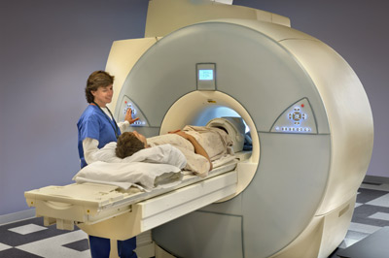
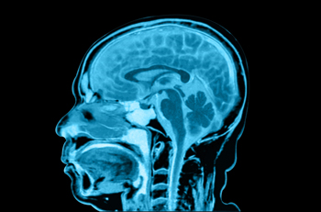
What are superconductors good for?
In an electromagnet, current traveling in a loop generates a magnetic field. To generate an intense magnetic field requires a high current, and this means for ordinary conductors a lot of energy is lost as heat. A superconductor avoids this problem. The current will circulate around and around and never lose energy to heat or stop, as long as the material is kept below T_{c}.
This is now used in scientific instruments based on nuclear magnetic resonance (NMR) spectroscopy, like magnetic resonance imaging (MRI) instruments. Typically, these use NbTi superconducting wires.

Slide 18

What are superconductors good for?
A permanent magnet that moves close to an electrical conductor sets up currents in the conductor that generate a magnetic field. This magnetic field opposes the field of the permanent magnet, creating a force that slows the object.
https://www.youtube.com/watch?v=uh0bbW6S3BY

Slide 19
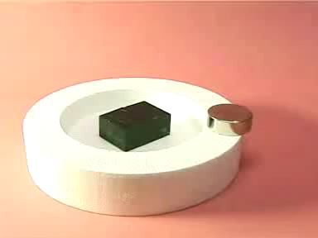
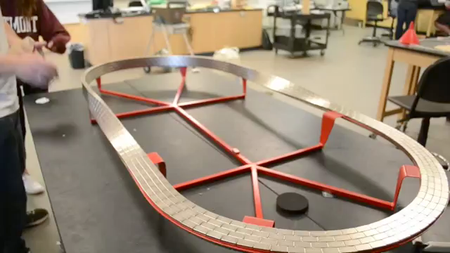
What are superconductors good for?
If the conductor were perfect (a superconductor), the magnet wouldn’t fall at all! It would be suspended, because the magnetic field generated by the conductor would exactly oppose the magnetic field of the magnet. It would levitate!
This can be done with superconductors (which now function up to 134 K, 57 degrees above liquid nitrogen temperature)!
https://www.youtube.com/watch?v=nWTSzBWEsms
https://www.youtube.com/watch?v=wTAJiD5MSR8

Slide 20
Ceramics
Inorganic ionic solids, typically hard and brittle, and stable to high temperatures. Often these are metal oxides, nitrides, carbides, silicates, or aluminates. Generally, these are insulators, but some (like YBa₂Cu₃O₇) become superconductors at low temperatures. Some are used as synthetic gemstones.
Examples:
Al₂O₃ – used for supports for electron/ion optics in mass spectrometers, and in sandpaper
SiO₂ – used in silica gels; mixed with borates to form glass
SiC – used in “carborundum” sandpaper
ZrO₂ - cubic zirconia – a synthetic gem.
BeO – has a high thermal conductivity. Previously used in high temperature applications.
(now largely avoided due to Be toxicity)
Y₃Al₅O₁₂ – yttrium aluminum garnet (YAG) – used as a host crystal for Nd3+ ions in
Nd:YAG lasers.
B₄C – boron carbide – used in bulletproof vests, tank armor

Slide 21
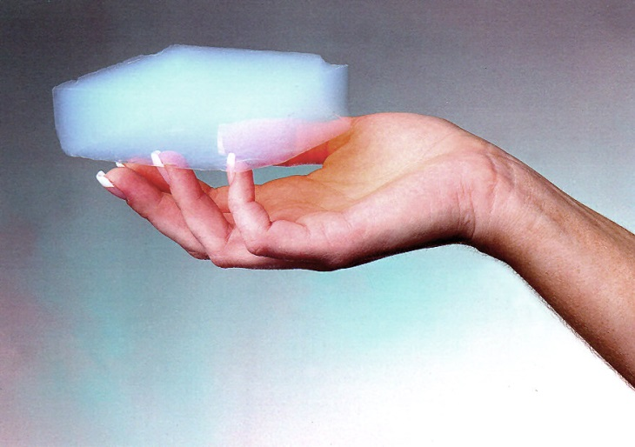
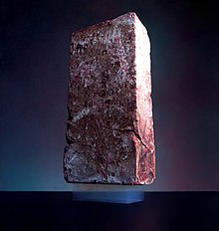

Aerogels
An interesting way to form ceramics without a regular crystalline structure is to start with a precursor like Ti(OC₂H₅) or Si(OC₂H₅) which may be dissolved in ethanol and is slowly hydrolyzed when H₂O is added. This may be used to make crosslinked TiO₂ or SiO₂ networks that lack a regular crystalline order, but which are highly porous (silica gel, for example).
Even more interesting, if the material is produced under conditions were the solvent can be replaced with a supercritical gas, which is then removed, the gel will not collapse. An extremely lightweight and porous material (an aerogel) is then formed. The resulting structure can be 98% air by volume, and only 2% SiO₂. These are superb insulators, and excellent supports for catalysts because the reactants and products can readily reach the catalytic sites.
2.5 kg brick supported by a
2 g piece of aerogel
Images from Wikipedia “Aerogel” article.

Slide 22
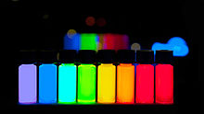
Quantum Dots – semiconductors at the nanoscale
Quantum dots are very small semiconductor particles, several nm in size. These are made from materials with direct band gaps, so they fluoresce extremely well. These are inorganic compounds like ZnS, CdSe, PbS, PbSe, InAs, or InP. As the particle size is made smaller, the band gap increases. This allows the fluorescence (and absorption) wavelengths to be varied as a function of size.
Because these materials are so small, absorb light so effectively, and fluoresce with such high efficiency, they’re potentially useful for many applications. For example, they could be coated with an antibody to an virus or bacterium, and used in a test to see if that pathogen is present in a biological sample (blood plasma, etc.) They are also being explored for electronic applications, and laser applications.
A variety of ZnS, ZnSe, CdS, CdSe quantum dots are shown, fluorescing under illumination by UV light.
http://www.plasmachem.com/shop/en/226-zncdses-alloyed-quantum-dots, CC BY-SA 3.0, https://commons.wikimedia.org/w/index.php?curid=26950552

Slide 23
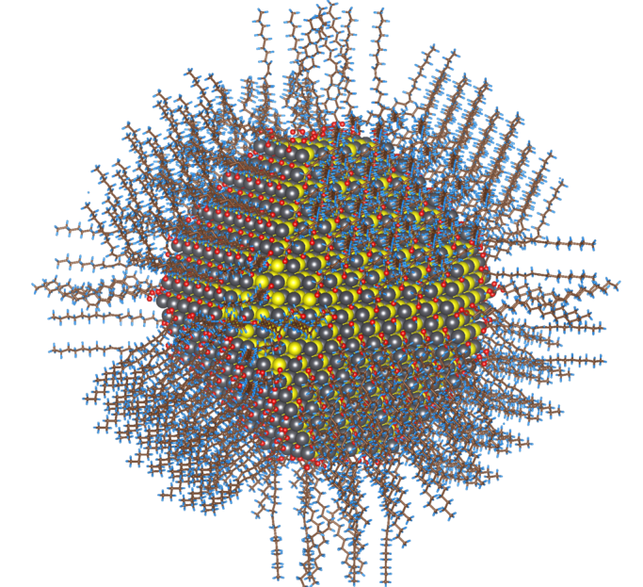
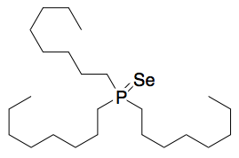
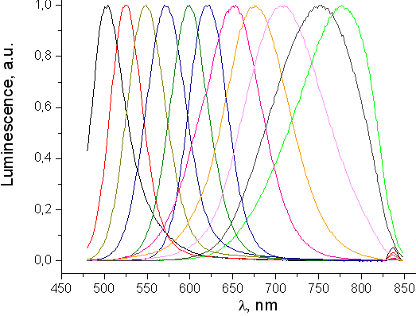
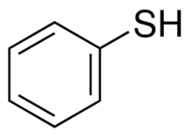
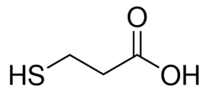
Quantum Dots – How are they made?
Like aerogels, quantum dots are prepared by mixing precursors that must be activated to react. An example is
Cd(CH₃CO₂)₂ [cadmium acetate] mixed with trioctylphosphine selenide:
The mixture is heated in the presence of a capping agent, Se is slowly released and reacts with Cd to form CdSe nuclei, which grow under controlled conditions. The capping agent eventually covers the quantum dot’s surface, preventing further aggregation and stabilizing the colloid.
Some capping agents:
thiophenol:
mercaptopropionic acid:
By Zherebetskyy - Using Vesta visualisation software plotted the developed model similar to the Science paper, CC BY-SA 3.0, https://commons.wikimedia.org/w/index.php?curid=33602351
Fluorescence spectra of CdTe quantum dots of various sizes.
By Antipoff at English Wikipedia, CC BY-SA 4.0-3.0-2.5-2.0-1.0, https://commons.wikimedia.org/w/index.php?curid=36866850

Slide 24
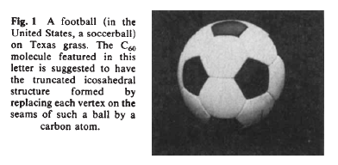
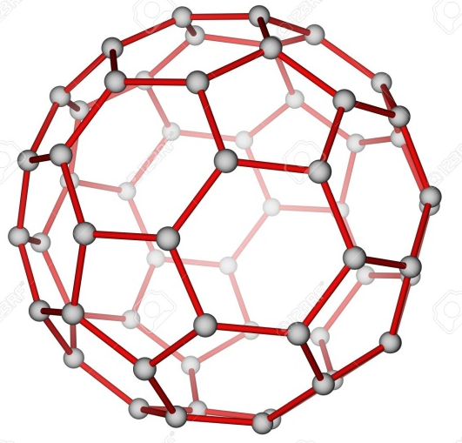
Fullerenes and Carbon Nanotubes
Fullerenes are a class of molecules that form closed sphere-like or ellipsoidal shapes. They resemble graphite in that all carbon atoms are sp² hybridized, and each atom is bonded to 3 other atoms. In addition to the sigma bonds to the three carbons, there is a network of pi bonds that extend over the entire surface of the molecule. These molecules all have 12 pentagons, and any number of hexagons (0 hexagons = C₂₀; 20 hexagons = C₆₀; etc.) The most symmetrical fullerene is C₆₀, which is the smallest one where no pentagon borders another pentagon. It is just like a soccer ball, and is the most abundant fullerene formed in any synthesis.
soccer ball C₆₀

Slide 25
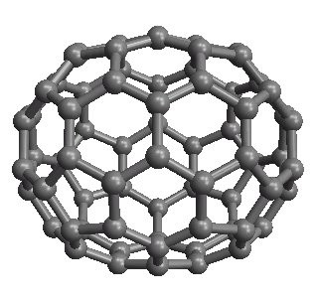
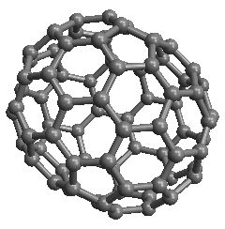
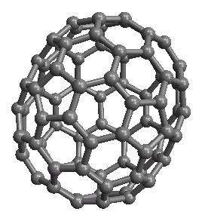
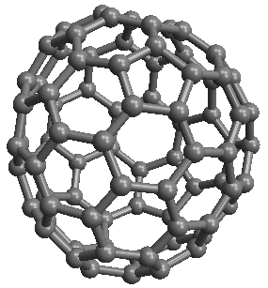
Other Fullerenes
C₇₀ C₇₆ C₈₂ C₈₄
By far, the most studied of these is C₆₀, since it is by far the most readily produced. It can be
reacted with transition metals to form novel organometallics;
partially hydrogenated or halogenated, forming C₆₀H₁₈, C₆₀H₃₆; C₆₀Br₂₄; C₆₀F₄₈
reacted with alkalis to form superconducting salts in which it accepts electrons to form species like Cs₃C₆₀ (taking 3 electrons to form the C₆₀³⁻ ion).
attached to polymers to be immobilized in solar cells, where it makes a good electron acceptor

Slide 26
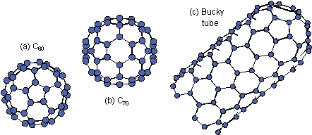
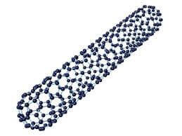
Carbon Nanotubes
Carbon nanotubes are just like to fullerenes, just with a lot more hexagons:
C₆₀
C₇₀
Nanotube (open-ended variety)
Nanotube (closed-ended variety)
Just like fullerenes, still needs 12 pentagons to close the structure – and a lot of hexagons to make the long tube.

Slide 27
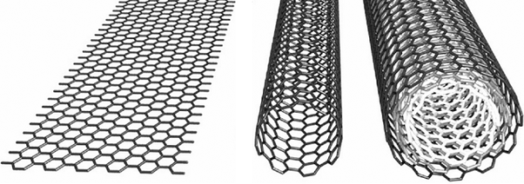

Carbon Nanotubes
You can understand carbon nanotubes as a sheet of graphite, rolled up to make a tube:
Graphite sheet Single-walled nanotube Multi-walled nanotube
Actual scanning tunneling microscopy (STM) image of a single-walled carbon nanotube. The hexagons are clearly visible.

Slide 28
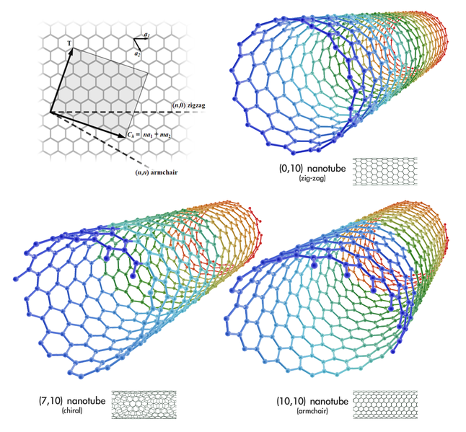
Carbon Nanotubes
You can curl up a sheet of graphite in various ways that all match up the dangling bonds to create a possible structure. These are characterized by two indices (n,m). Each different (n,m) has slightly different (sometimes very different) properties.
Some are metallic, and conduct electricity very well. Some are semiconductors, and can be used to create light-emitting systems. Some are even chiral, giving a spiral that can twist to the right or to the left.

Slide 29
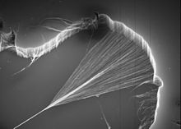
Carbon Nanotube Applications
Current Uses (all based on bulk masses of nanotubes, utilizing their tensile strength):
Bicycle components – lightweight and extremely strong (bulk masses of nanotubes)
Lightweight boats – a 54’ vessel weighing 8,000 pounds has been built that can carry 15,000 pounds of cargo over 2500 miles
Mixed with epoxy to form lightweight composites 20 to 30% stronger than other materials, used for skis, ice hockey sticks, hunting arrows, surfboards, wind turbines
Tips for atomic force microscopy probes
Potential future uses:
Microelectronics – individual nanotubes can be used as circuit elements. Very difficult to assemble the circuit however.
Radar absorbers – nanotubes absorb radio frequencies well, so they may be useful in coating military aircraft to make them less visible on radar.
High-strength alloys – aluminum-nanotube composites have similar strength to stainless steel at 1/3 the density. Potentially useful in aircraft and even automotive applications.
Textiles – including bullet-resistant fabrics
Solar cells – useful because they are
strongly absorptive in visible and UV
Carbon nanotubes being spun into yarn

Slide 30
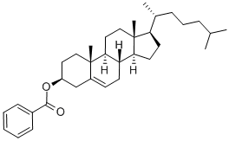
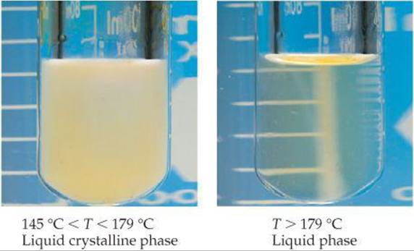
Liquid Crystals
Liquid crystals are a class of materials that don’t go directly from a regular crystalline solid structure to a structure that is completely disordered upon melting. When the solid is melted, they retain some order that is lost at particular phase transitions at higher temperatures.
First discovered in 1888 by Friedrich Reinitzer (Austria), liquid crystals aren’t really new. Reinitzer discovered that cholesteryl benzoate seems to have two melting points: At 145.5⁰C it melts into a cloudy liquid, and at 178.5 ⁰C the cloudy liquid becomes clear. And this process is reversible, with clearly defined transition temperatures!
Also, like other first-order phase
transitions, there is a ΔH for the
process (like the enthalpy of fusion,
or of vaporization).

Slide 31
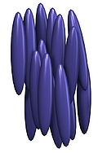
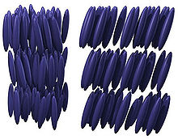
Liquid Crystal Phases
Liquid crystals display various types of ordering (a kind of self-assembly), which depend on temperature or other external variables, like an electric or magnetic field.
Nematic phase: Long molecules align like rods, with directional ordering, but the location of the molecule’s center of mass is disordered. Some can orient along a second axis as well. Often these molecules are easily aligned by an electric field, making them useful in liquid crystal displays. (FYI: nematic comes from the Greek word for “thread”.)
Smectic phase: Molecules are positionally ordered along one direction, as well as directionally ordered. In the smectic A phase, the molecules are oriented along a normal to the layers; in smectic C phase, they’re oriented at an angle.
Upon cooling from the fully disordered liquid, some materials first go through a nematic phase, then a smectic A phase, then a smectic C phase, and then finally crystallize.
Figures from Wikipedia
Nematic Smectic A Smectic C

Slide 32
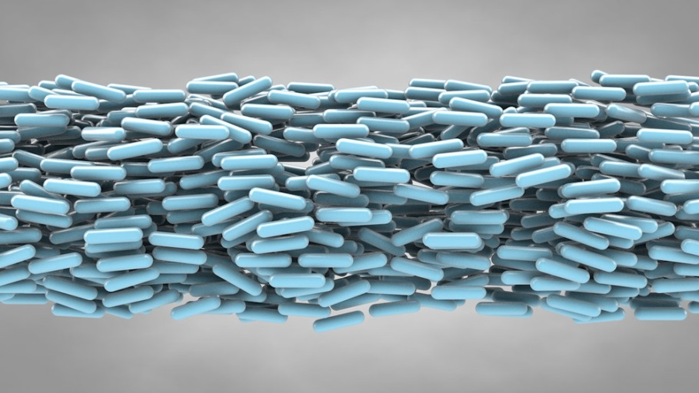
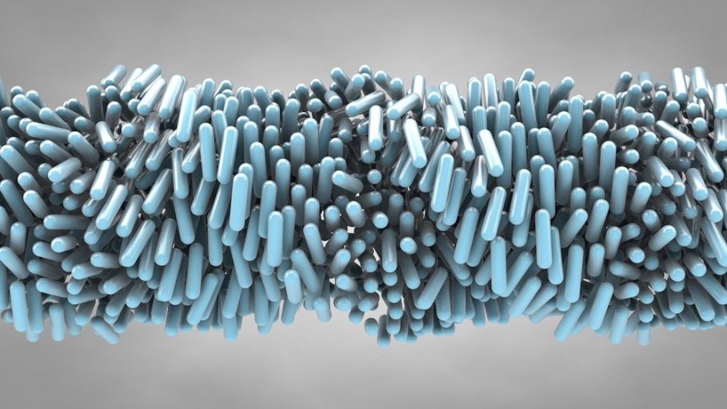
Chiral Liquid Crystal Phases
When liquid crystals have a chiral structure, sometimes that chirality is imposed on the long-range liquid crystal order. The result is an interesting liquid that can rotate the polarization of light. This was first observed in cholesterol derivatives, and is called the cholesteric phase, and results from the asymmetric packing forces between the molecules.
λ/2
Nematic phase Cholesteric (also called chiral nematic phase)
The cholesteric phase has a wavelength (the pitch – the same word used to describe screws) associated with the twisting of the molecules, and this varies with temperature. When the pitch is similar to the wavelength of visible light, this can be used to make useful optical devices. The twisted phase rotates the plane of polarization of light, allowing light to pass through crossed polarizers. When the molecules are aligned in one direction using an electric field, light can no longer pass between the crossed polarizers. This is the basis of liquid crystal displays.
Figures from: http://www.beautifulchemistry.net/liquid-crystals/

Slide 33
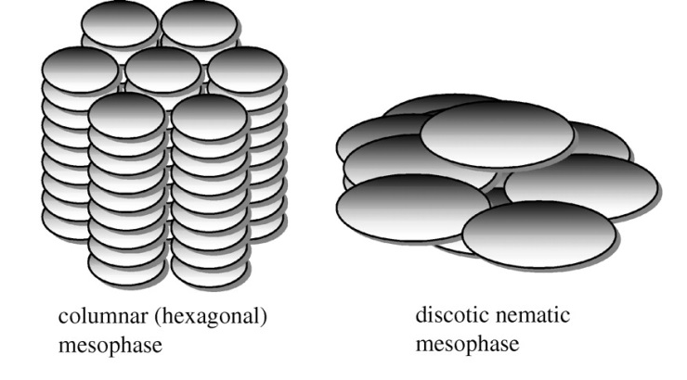
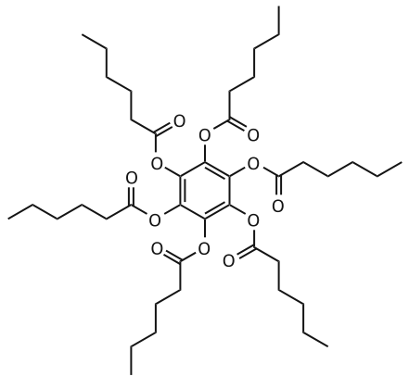

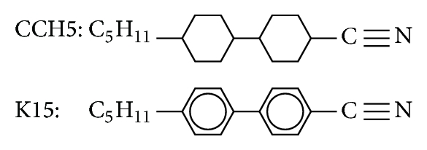
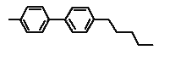
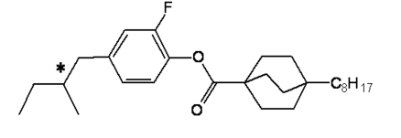
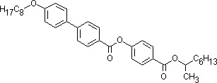

Molecular Requirements for Liquid Crystals
Generally, long and rod-like
Often with a large dipole moment that favors a specific orientation relative to each other
Fairly rigid, so they can’t bend and entangle with each other
Disc-like structures can form discotic phases:
Examples of discotic liquid crystals:
Examples of nematic, smectic, and cholesteric liquid crystals:
N≡C
*
* indicates a chiral center – these are cholesteric liquid crystals

Slide 34
Thanks for listening!
Anytime you’d like to ask me a question:
morse@chem.utah.edu
This and all previous presentations can be found at my website:
https://chem.utah.edu/directory/morse/research-group/ap_chemistry_powerpoints.php

